Slide 1

STAKEHOLDER PROGRESS REVIEW
REVIEW CONTEXT
L&S Business Hub
Prepared for the stakeholder
review team.
Staging review: recent updates and guided testing
This deck is about demonstrating
progress, collecting feedback and
A shared walkthrough of the current in-progress build
testing boundaries—not declaring
completion.

Slide 2
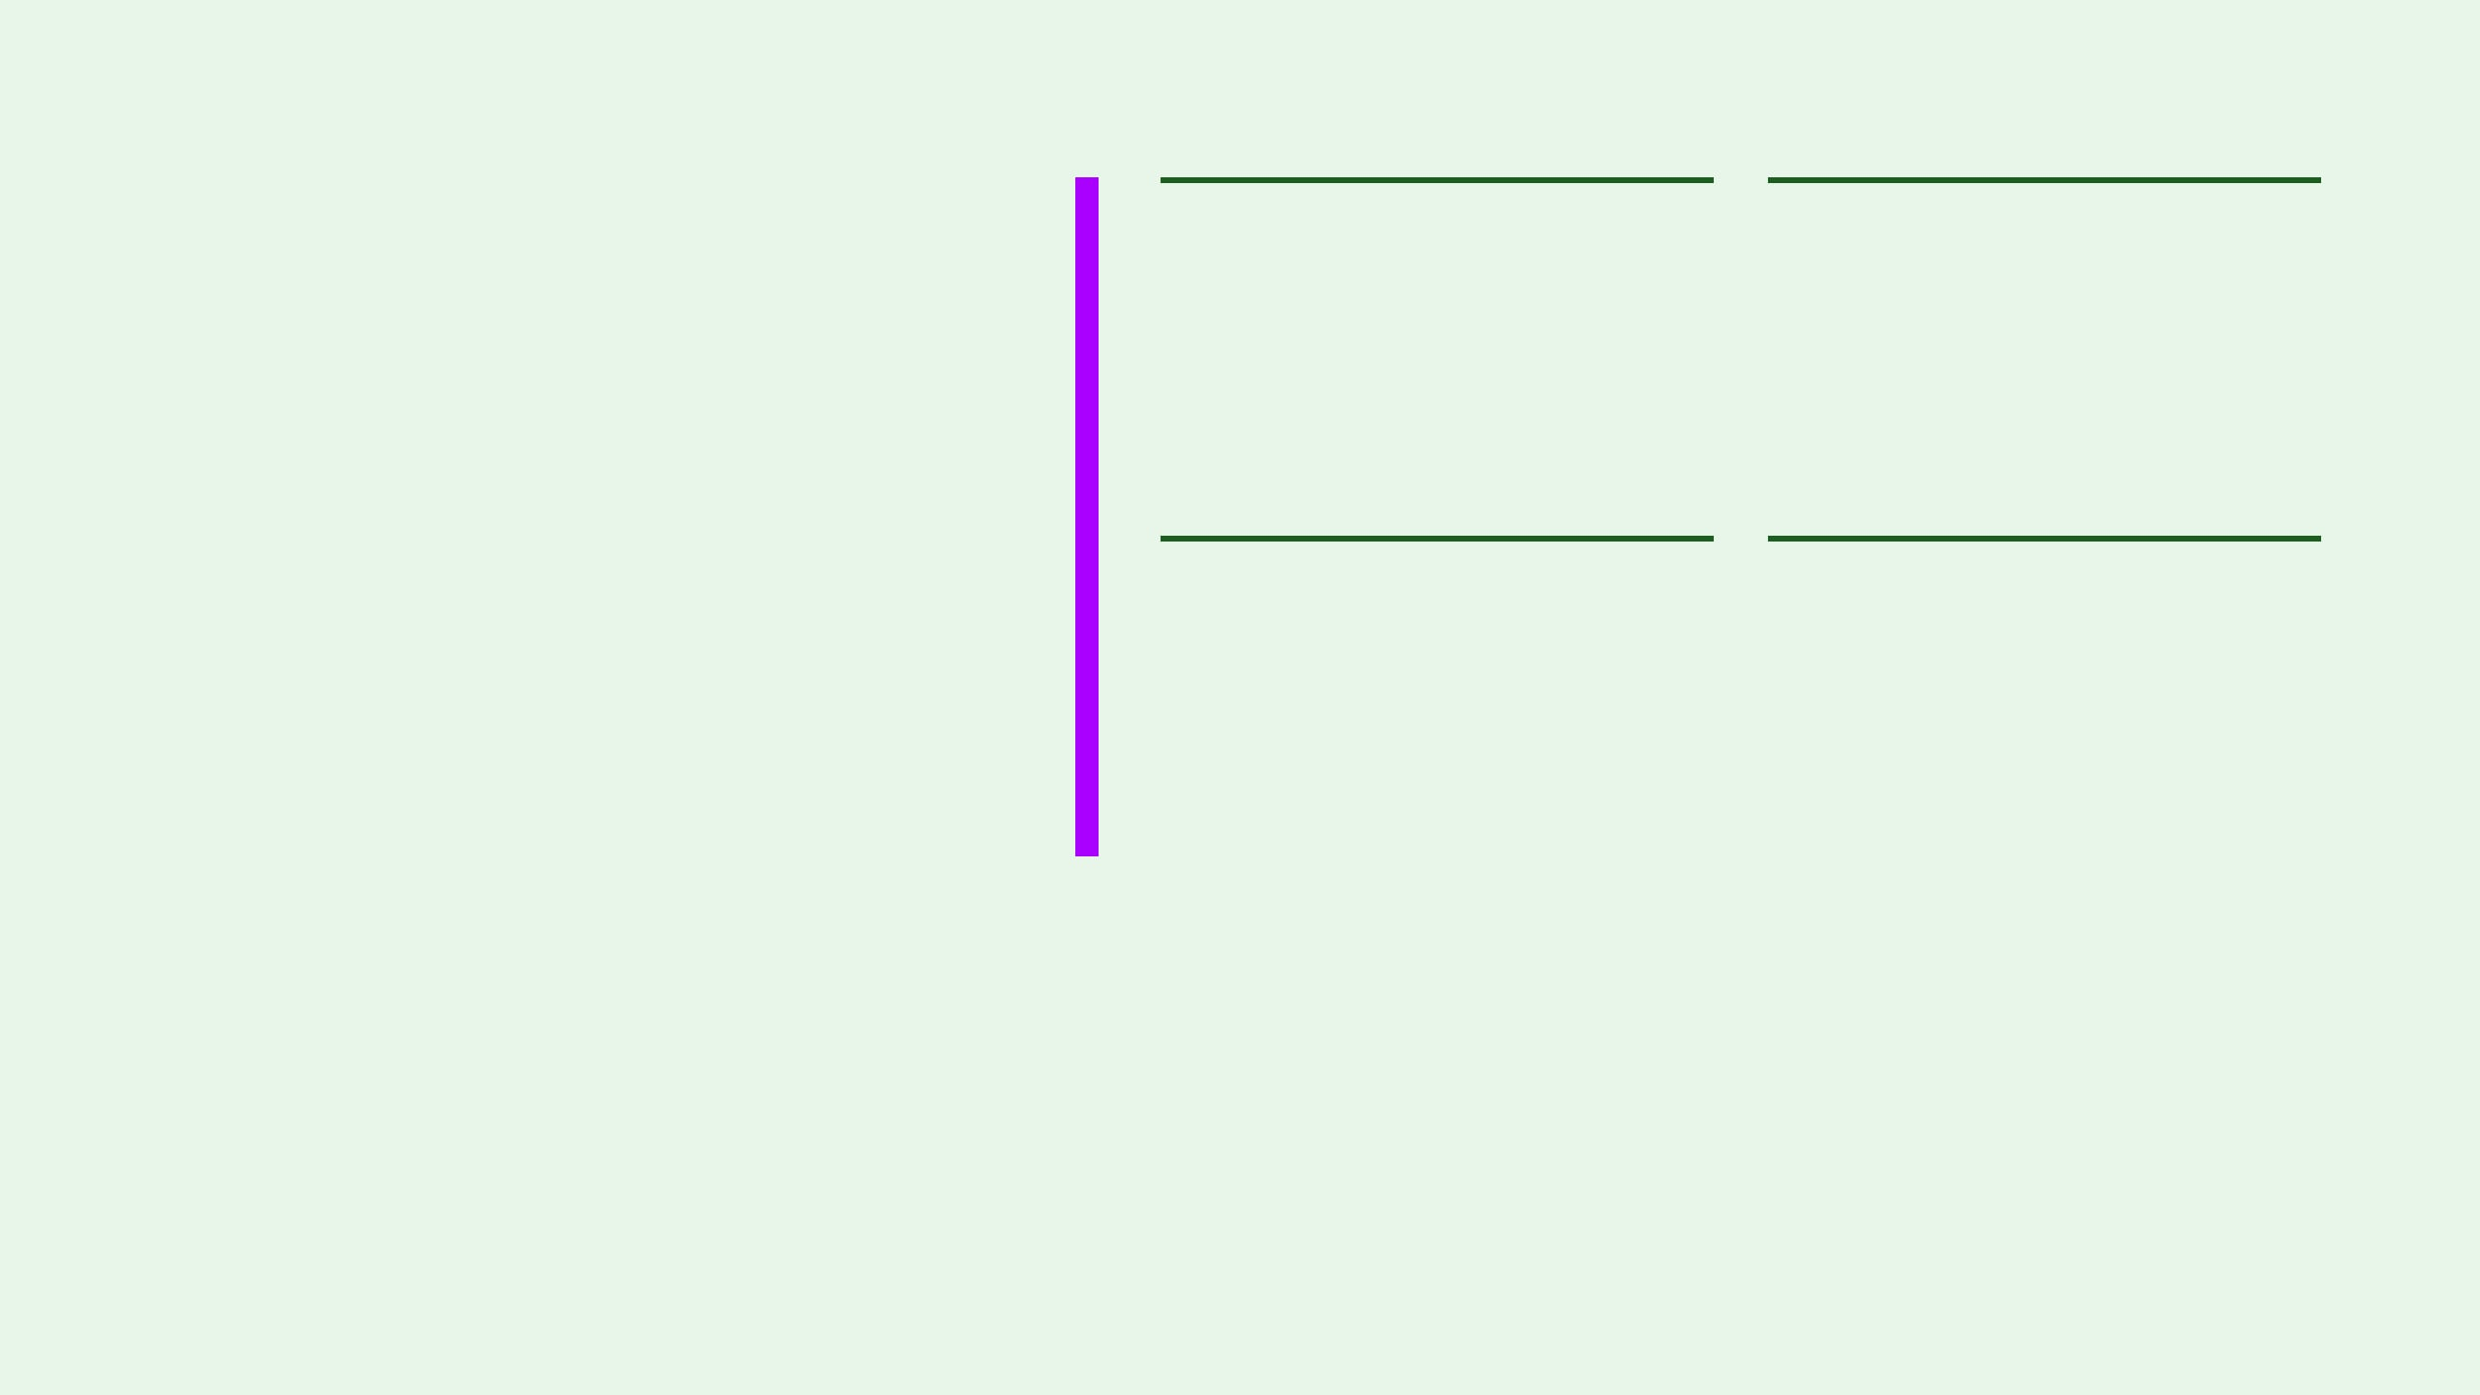
01 / REVIEW FRAME
Today is a progress review, not a final launch
01
02
Walk through
Compare portals
See the current staging updates in one shared environment.
Review the distinct internal and external experiences.
The purpose of staging is to make recent updates visible, test the new boundaries and decide what should improve next.
03
04
Test safely
Shape the next cycle
Use fictional identities and controlled negative tests.
Capture feedback while the product is still evolving.
A working demonstration is not a production-readiness declaration.

Slide 3
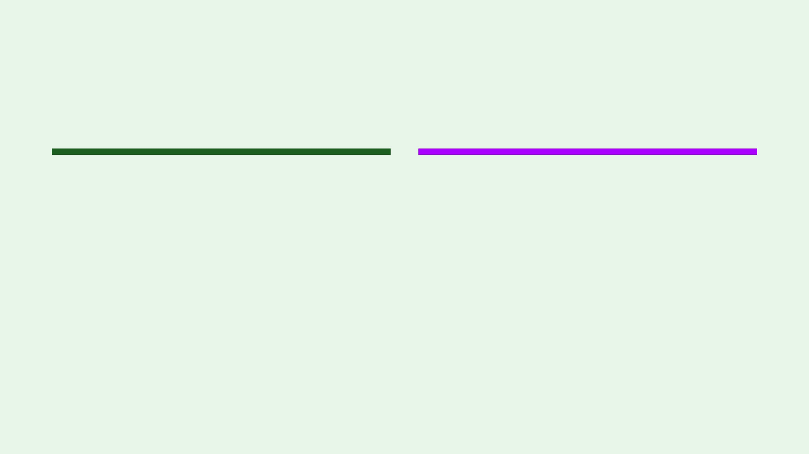
02 / SHARED WORKSPACE
The staging environment is the shared review workspace
EXPERIENCE LAYER
DATA AND ACCESS LAYER
Vercel staging
Supabase Cloud staging
The current Next.js experience is online at one stakeholder-facing deployment, making each review concrete and repeatable.
The isolated database, authentication and private-storage boundary lets us test the experience with controlled scope.
Boundary: This environment is independently resettable and contains fictional data only. It is a place to review progress, not a final release surface.

Slide 4
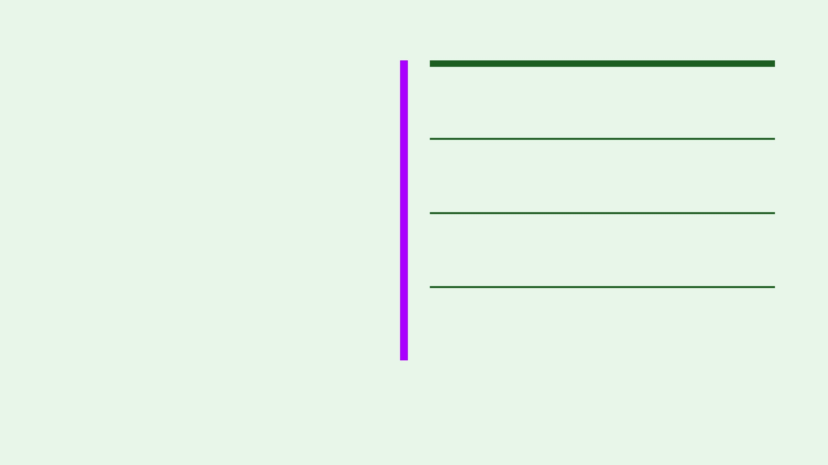
03 / RECENT UPDATES
Recent updates establish the product foundation
01
Multi-company workspace
Internal staff can work across authorized business-company contexts without treating every record as one shared pool.
02
Separate client portal
External users receive a narrower, client-safe experience with distinct navigation and terminology.
The current staging build now makes the core operating model visible enough to review, challenge and improve.
03
Session-bound access
Standard data fetching stays attached to the authenticated session so database RLS remains the access boundary.
FOUNDATION WORK IS NOT FEATURE COMPLETION.
04
Initial dashboard surfaces
Fictional companies, partners, service orders and invoice summaries now appear for guided staging review.

Slide 5

04 / INTERNAL STAFF WALKTHROUGH
Internal staff can review the operating model
Question for the review: Does the current staging experience make authorized day-to-day operations easier to understand without mixing company scopes?
01
02
Companies
Partners
Review the two fictional companies and confirm that authorized coverage is clear.
Check whether partner counts, types and contact presentation feel useful.
03
04
Service orders
Workflow clarity
Explore fictional frequencies, descriptions, statuses and contract values.
Note labels, missing steps and anything that would slow a real review.
Reviewers: business owner + Ishika · Use DEMO/SAMPLE records only · This is not a final operations release

Slide 6

05 / CLIENT EXPERIENCE
The client portal is intentionally narrower
VISIBLE IN THE CURRENT STAGING VIEW
Client-safe business context
Organization identity, fictional invoice summaries, payment status and outstanding amounts are presented through the client-safe data path.
INTENTIONALLY EXCLUDED
Internal information stays internal
The current design gives external users a clear organization context and a safe view of only the information intended for them.
Internal notes, vendors, employee data, audit content and operational details are not part of the client surface. Explicit document sharing is required rather than assumed.
REVIEW THE BOUNDARY, NOT JUST THE SCREEN
STAGING REMINDER
This is a controlled demonstration of the current portal direction. It is not a completed external release or approval to use real client information.

Slide 7
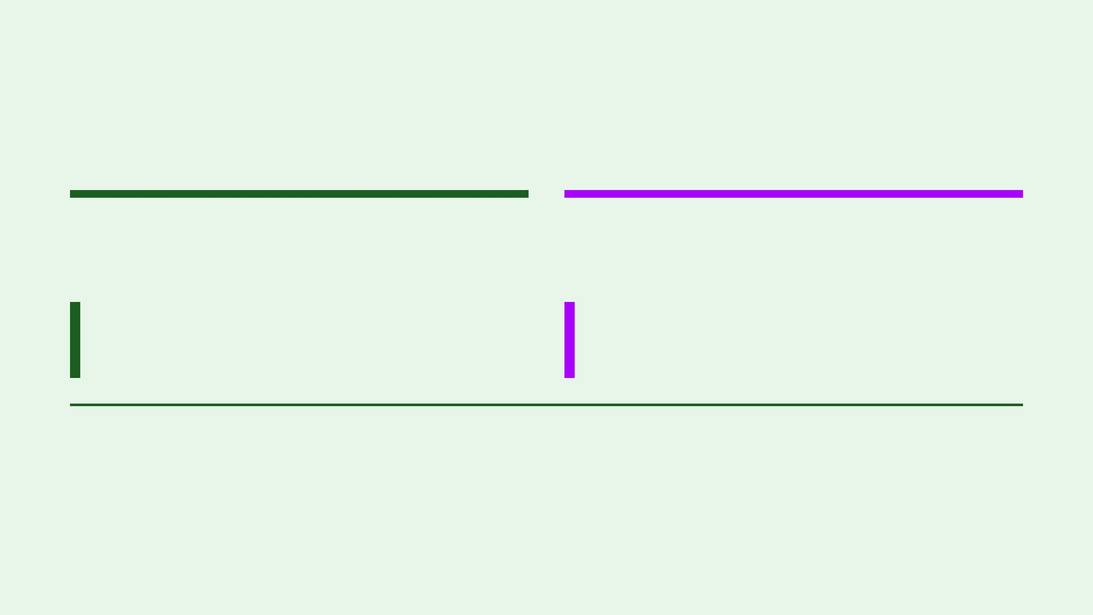
06 / GUIDED TESTING
The testing checklist makes security review repeatable
Internal staff
External client
Review the operating model and prove a staff session stays within its authorized company.
Review the narrower portal and prove Client A cannot reach Client B information.
01 Navigate companies, partners and service orders.
01 Open Client A's safe invoice summary.
02 Try a foreign fictional company ID.
02 Try Client B's fictional invoice and path.
03 Confirm cross-company records do not appear.
03 Confirm private uploads and downloads fail.
STOP RULE
EVIDENCE
If foreign data appears, stop immediately and report it as Critical. Do not continue probing.
Record identity, route, fictional ID, steps, expected result, actual result and a safe screenshot.

Slide 8
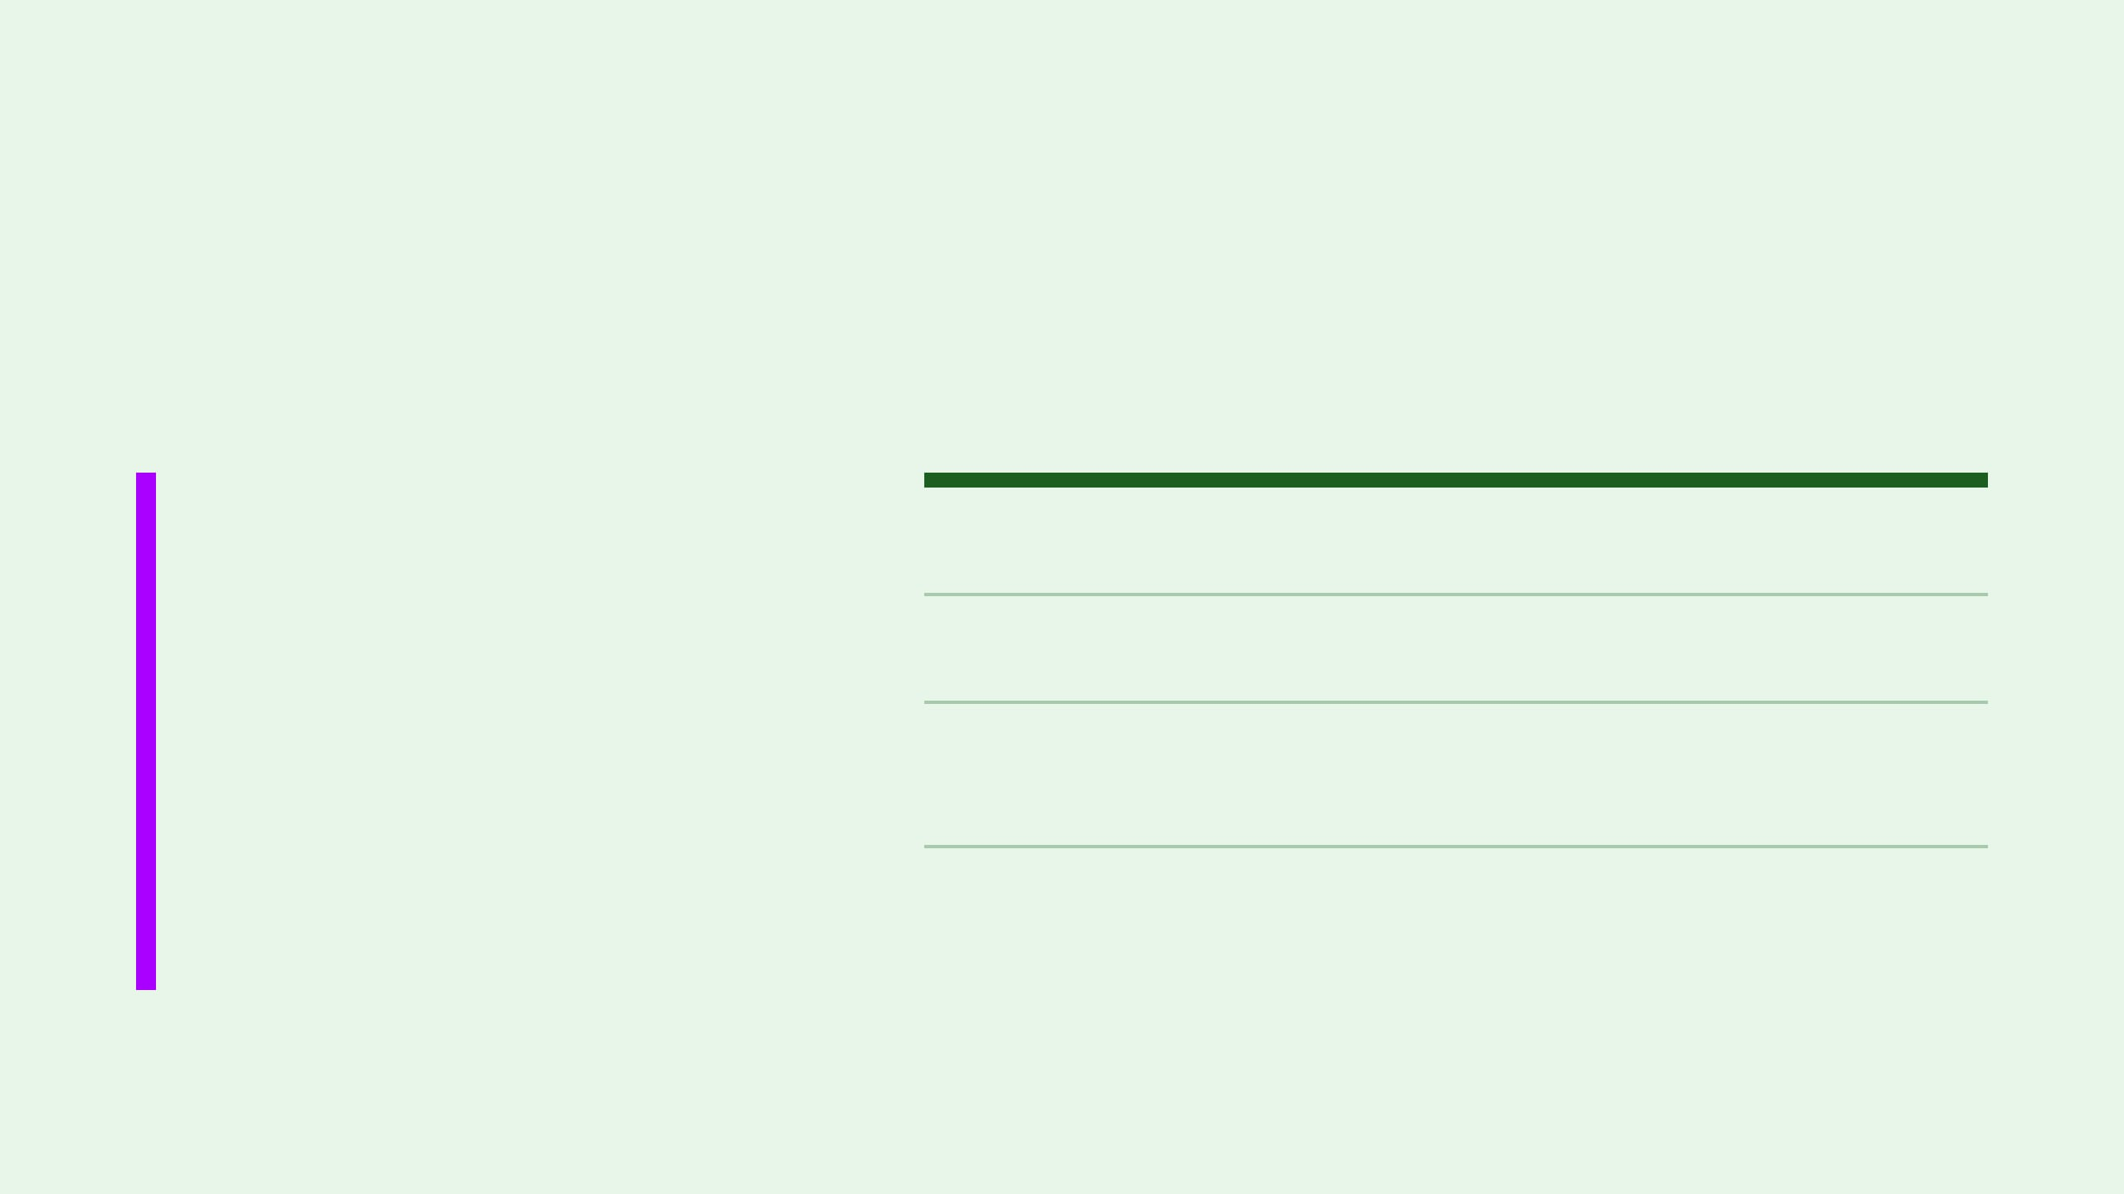
07 / DATA BOUNDARY
All visible records are fictional DEMO/SAMPLE data
The staging environment is designed for review and testing. It is not approved for real business information.
01
Two internal companies
DEMO / SAMPLE
DEMO LIFT & SHIFT and DEMO SISTER COMPANY ONE.
02
Four client organizations
Alpha, Beta, Gamma and Delta demo organizations for tenant-boundary testing.
03
Synthetic business records
Every visible company, client, invoice, payment and service-order record is synthetic review data.
Fictional invoice, payment, partner and service-order records support the walkthrough.
04
No real files or identifiers
No real names, amounts, tax identifiers, bank details, addresses, contacts or uploaded documents.
Reviewer rule: Do not enter, paste or upload real business information. If a record appears to contain anything real or unexpected, stop the review and report it immediately.

Slide 9
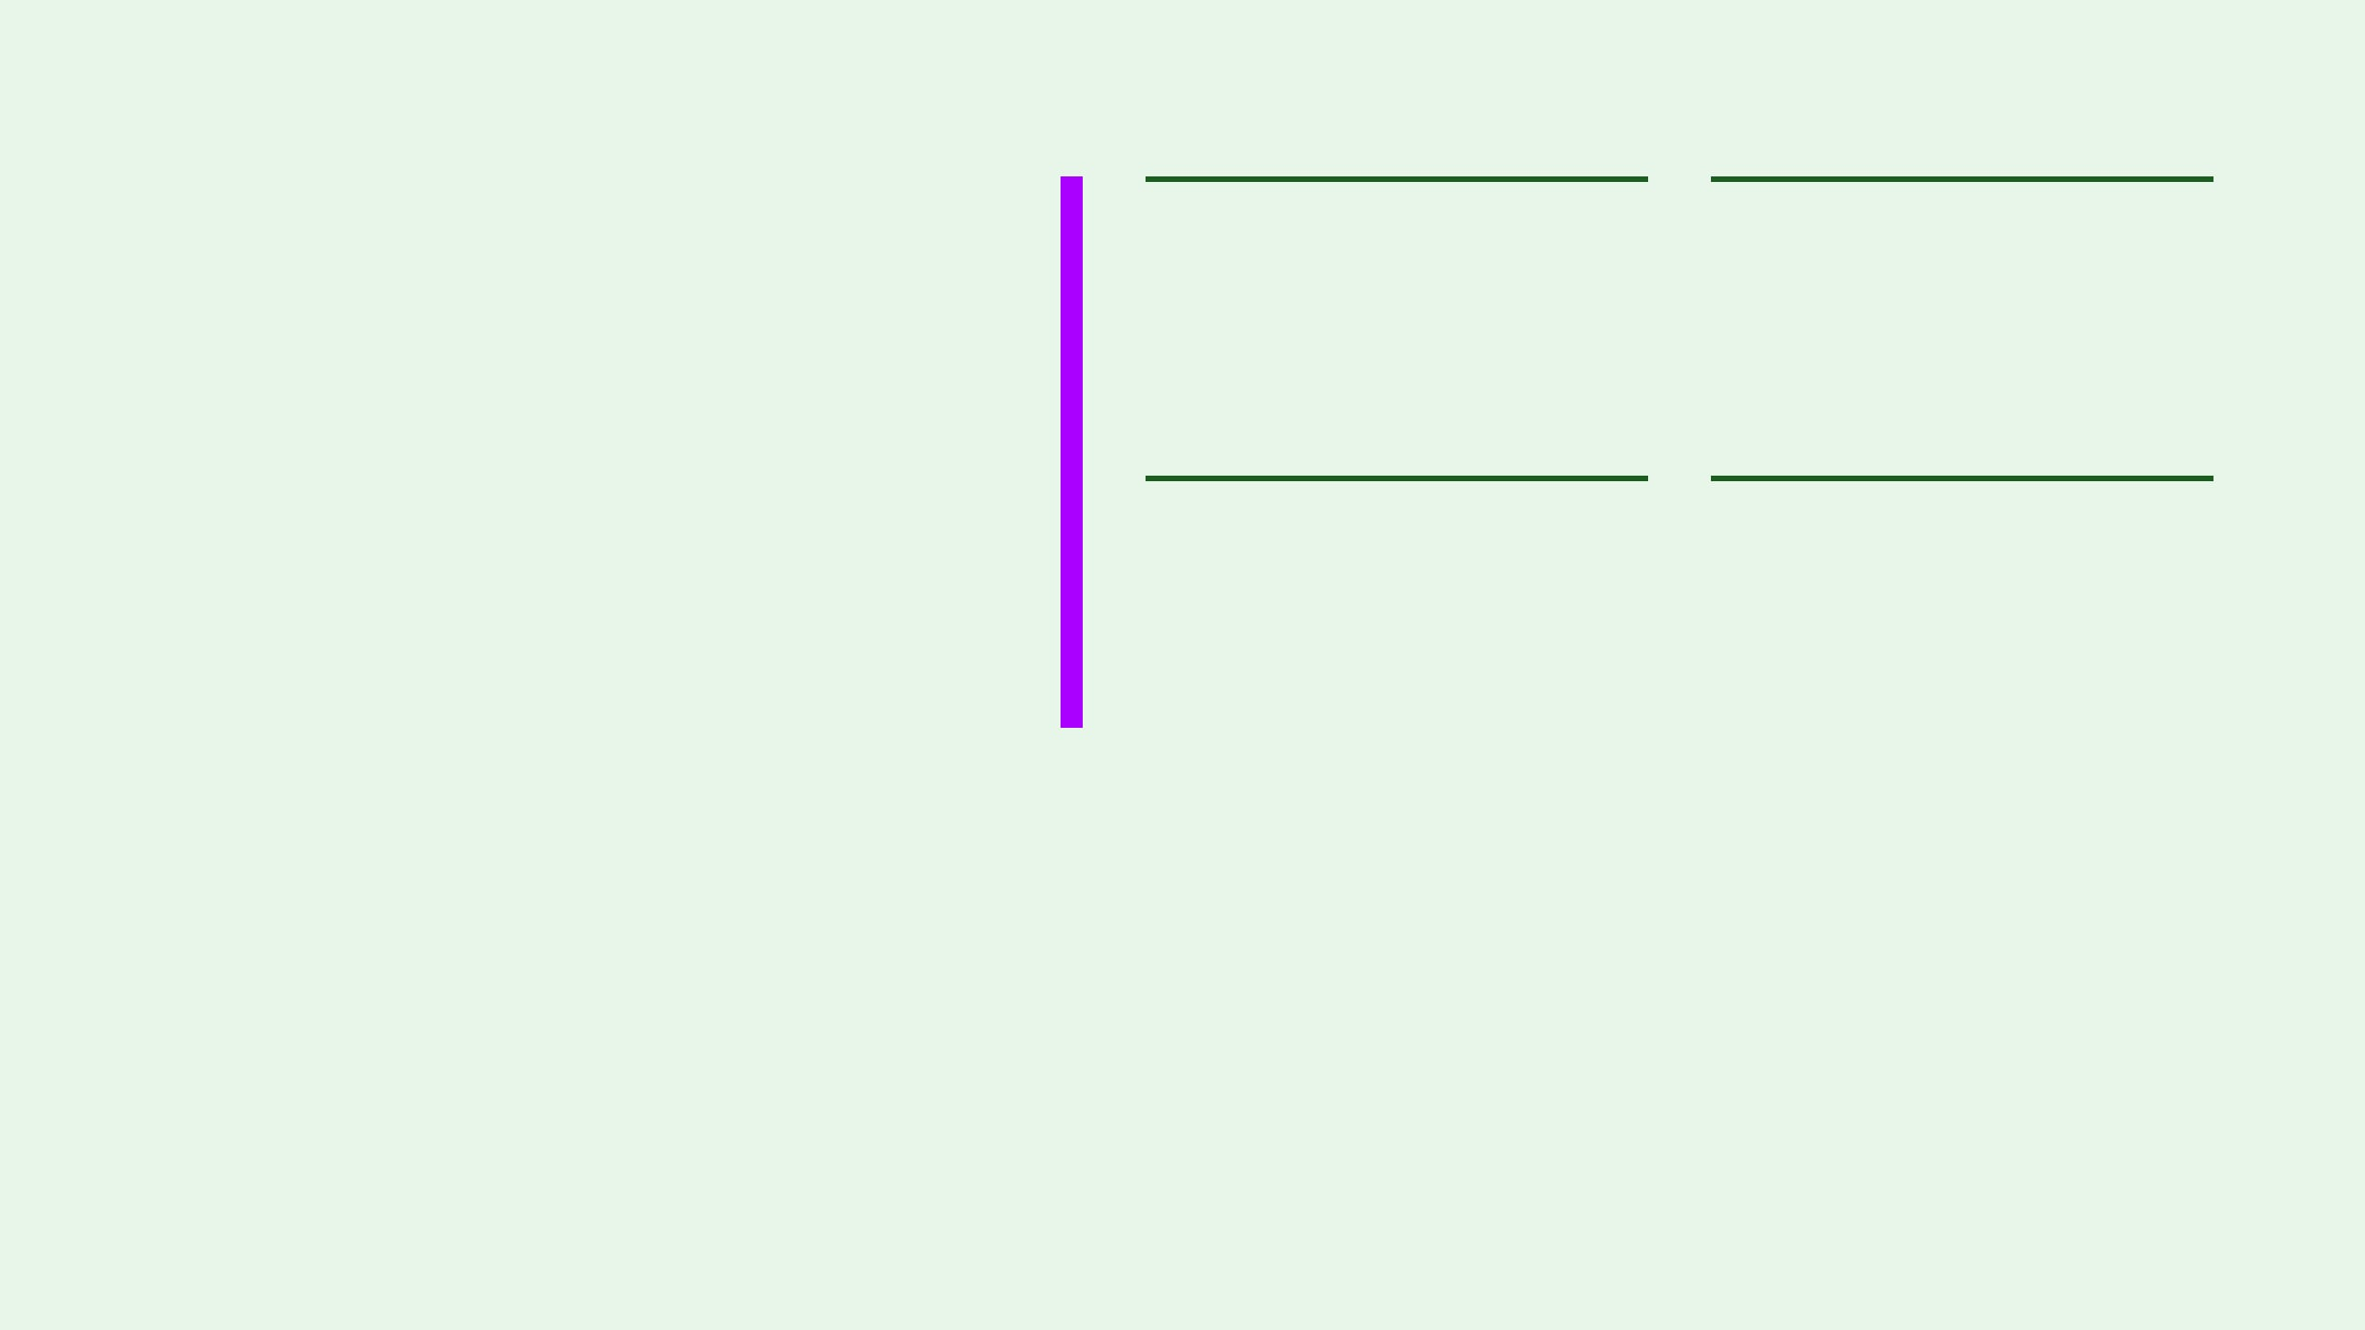
08 / NEXT INCREMENT
What we need from this review
01
02
Most valuable update
Clarity gaps
Which recent change feels most useful to the business workflow?
Where did the internal or client experience feel unclear or incomplete?
Your feedback helps us decide what to clarify, strengthen and build next while the product is still evolving.
03
04
Boundary confidence
Next review priority
Did company and client boundaries remain understandable during testing?
What should be addressed before the next staging walkthrough?
STAGING REVIEW · NOT A FINAL RELEASE
Outcome: capture practical feedback, prioritize the next increment and keep the staging environment clearly separate from a completed production product.

